Slide 1

PushPush It to the Limit
By: Georgina Xu and Hafsah Hanif
CSC 250: Theory of Computation
Professor J. Crouser
Final Project
April 2018
Notes:
Today, we are going to introduce you to a game, called PushPush, which was inspired and modified from “Sokoban,” an arcade game built in 1981 by a Japanese company. Then, we are going to prove to you that PushPush is NP-hard by a reduction from SAT.

Slide 2
Did anyone play PushPush as a kid?

Slide 3
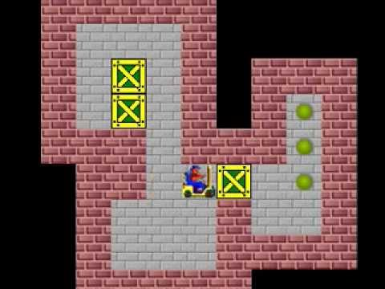
What is PushPush?
PushPush is a “sliding blocks” game with the following rules:
A robot pushes blocks to move between given start and finish (goal) positions
The robot can only push 1 block at a time. Each block slides the full extent of the available empty space in the direction it was pushed
Sokoban Level 2: https://youtu.be/UyNVirVWQUY
Notes:
First, what is PushPush? We are going to explain the rules, using this video of Sokoban, the original inspiration for PushPush. As you can see, the player (we call it “robot” here) is able to push the blocks from all four directions as long as there is empty space. In Sokoban, the goal is for the player to push all the blocks to the target location. However, in PushPush, the goal is for the player to get from the starting position to the finishing position, by pushing away all the blocks that are in their way. The player can only push 1 block at a time. In addition, unlike this video of Sokoban, where each block only moves 1 position, in PushPush, each block slides all the way through when it is pushed.

Slide 4
Why is This Relevant?
We will show that PushPush in 3D is NP -Hard using a reduction proof (SAT ≤_{p} PushPush)
SAT:
(x1 ∨ x2) ∧ (x1 ∨ ¬x2) ∧ (¬x1 ∨ x2 ∨ x3) ∧ (¬x1 ∨ ¬x3)
x1 = True; x2 = True; x3 = False
Notes:
(Pause and ask if people have any questions about the rules of PushPush)
After you understand the game, we are going to prove to you that PushPush is a NP-hard game by reducing from SAT. First of all, just to remind you about the structure of SAT. It consists of several clauses. Each clause is connected by operator AND, and inside each clause, each literal is connected by operator OR. In order to make this formula satisfiable, at least 1 literal in each clause must be TRUE. Here is an example of a satisfiable assignment.

Slide 5
Terminology: Gadgets
Gadget: a small tool that has a particular function
Two types of elementary gadgets:
One-Way gadget
Fork Gadget
Notes:
The goal of our reduction is to transform an instance of SAT to an instance of PushPush. Before we construct the model, let us define some terminology that will make it easier for you to understand the model. In the paper we found, the author uses the term “gadget,” which is just a fancier word for tool. There are two types of gadgets that are used to construct the model, “one-way gadget” and “fork gadget.”

Slide 6
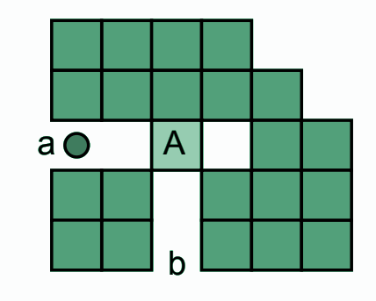
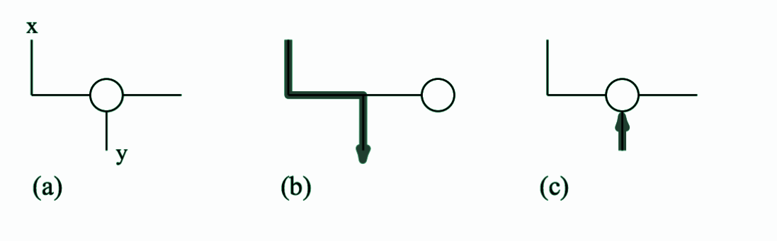
One-Way Gadget
In a One-Way Gadget, the robot can travel from x to y, but not from y to x.
Once the robot has travelled from x to y, however, it can move from y to x.
Notes:
A one-way gadget is where the player/robot can travel from x to y by pushing the block, but can’t travel from y to x. However, note that once the block is pushed, the player can move from y to x as well. The proof for this definition is that “The robot moving from x to y can push the block forward at the degree-three junction, but the block cannot be pushed when approaching from y because it cannot be pushed into a storage cell.”

Slide 7
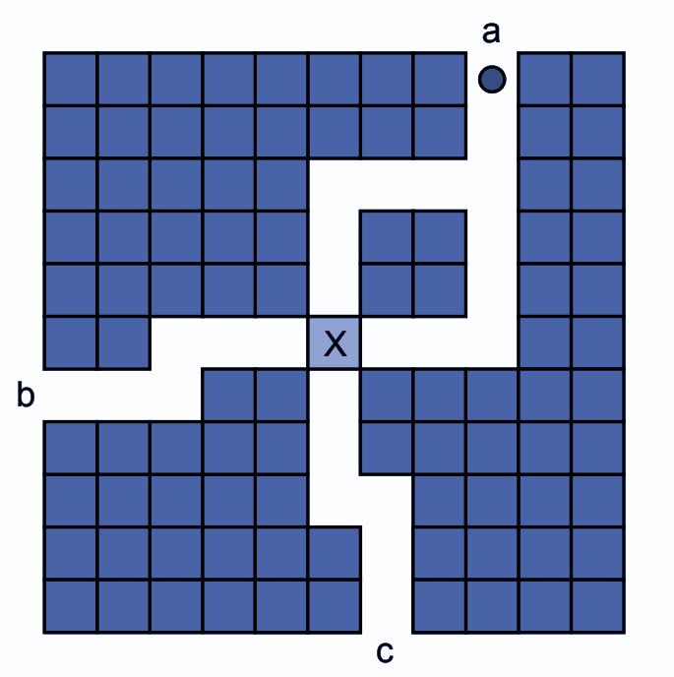
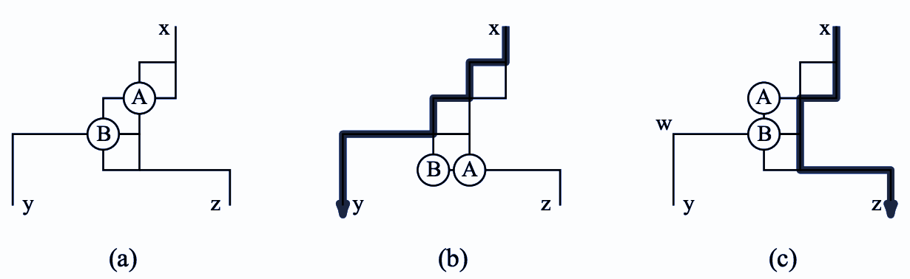
Fork Gadget
In a Fork Gadget, the robot can move from x to y, or from x to z. But, if the robot chooses (x → y) then it cannot move from (x → z). If the robot moves from (x → z), then it cannot move from (x → y)
Notes:
A fork gadget is where the robot can move from x to y, or from x to z. To move from x to y, the robot can push block A and B down. To move from x to z, the robot can simply push block A to the left. However, note that the robot can’t move from x to z anymore once it chose the x-y path. The proof for this definition is as follow: If the robot travels from x to y, the junction to z is permanently closed because A blocks the way. On the other hand, when the robot travels from x to z, the path to y will be permanently closed by block B.

Slide 8
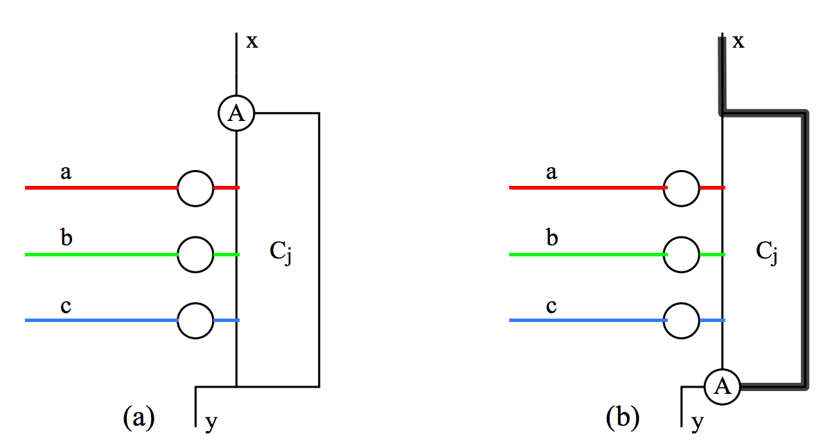
Clauses
A clause component is shown below. The robot can pass from x to y of a clause component if at least one block is pushed into it along an attached wire (a, b, or c).
A
Notes:
(Pause and ask if there is any questions about the definition of gadgets)
After defining the two types of gadgets, we will define another element in the model, called “clauses.” The robot can only pass the clause (from x to y) if at least 1 block is pushed into it along an attached wire. The proof for this claim is as follow: The robot travelling from x to y will push block A out of the way. Once A is pushed, it will move all the way down the wire and block the way to y if none of the blocks in the middle stops it. As you can see in the graph on the right, if 1 block in the middle is pushed into the clause, block A will stop and thus the robot can successfully go from x to y.
After you understand clause, now we are going to combine these three elements together, and also show you how the 3 blocks in the middle (a,b,c) could possibly be pushed.

Slide 9
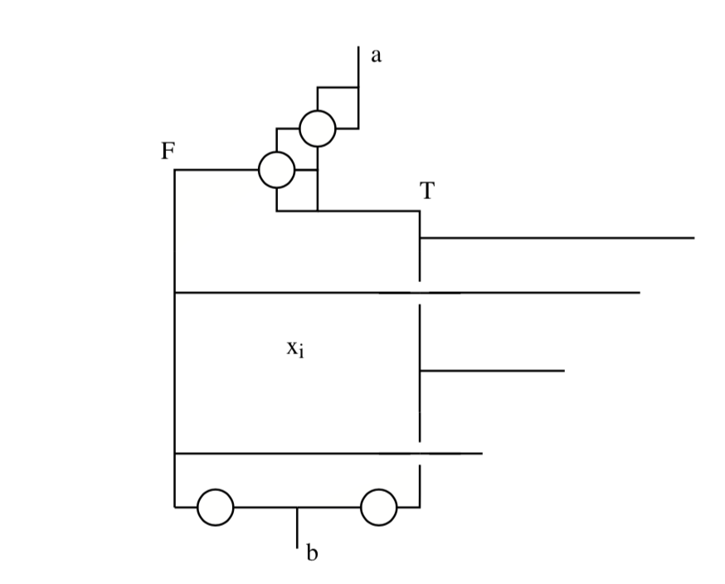
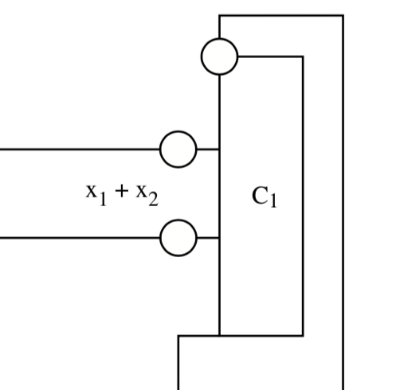
Variable-Setting Component
A variable gadget begins with a Fork Gadget, followed by two paths (F or T), each with attached wires exiting to the right.
Then it merges the the T and F paths via One-Way gadget, which prevents the robot from traveling both paths.
Notes:
We use the three elements defined before to construct a Variable-Setting Component, also called a Variable Gadget. It begins with a Fork Gadget, followed by two paths (False or True). Each path has attached wires to the clause on the right. For example, if the robot chooses the True path, you will follow the wire to the clause and push the block into the clause. This is how, in the previous slide, the blocks in the middle could be triggered and pushed.
After the robot pushed the block into the clause, it has no way else to go, so it will come back to the Variable Gadget on the left and continue following the wire. At the end of the Variable Gadget, the True and False paths are merged via a One-Way Gadget, which prevents the robot from traveling both paths.

Slide 10
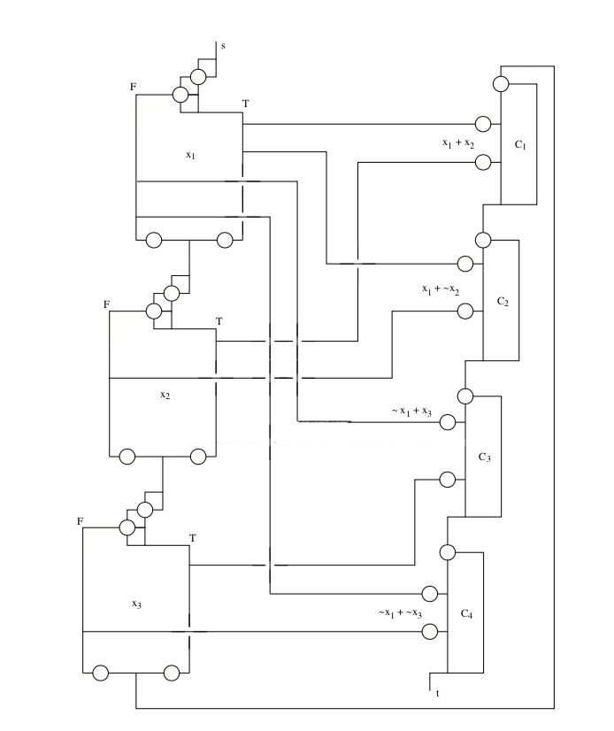


s
s
s
s
s
s
s
(x1 ∨ x2) ∧ (x1 ∨ ¬x2)
∧ (¬x1 ∨ x2 ∨ x3) ∧ (¬x1 ∨ ¬x3)
x1 = True; x2 = True; x3 = False
Reduction:
SAT ≤p PushPush
The robot can successfully go from Start (s) to Finish (t) if and only if all four clauses C1 C2 C3 C4 are satisfied
NOTE: Crossover (intersection of two orthogonal lines) in 3D prevents leakage
~x₁ + x₂ + x₃
t
t
t
t
t
t
t
Notes:
After you understand the Variable Component in the previous step, we will now show you the complete model for PushPush, which is constructed by 3 variables and 4 clauses. The graph could have more variables and clauses, depending on the SAT formula we reduce from. Here, we are only using the example formula (x1 ∨ x2) ∧ (x1 ∨ ¬x2) ∧ (¬x1 ∨ x2 ∨ x3) ∧ (¬x1 ∨ ¬x3), so the model only needs 3 variables gadgets and 4 clauses.
To go from s to t, the robot must follow the path below: First, the robot must go through each Variable Gadget one by one, and then it follows the wire from x3 to C1, and it must successfully go through all Clauses.

Slide 11
s
s
s
s
s
s
(x1 ∨ x2) ∧ (x1 ∨ ¬x2)
∧ (¬x1 ∨ x2 ∨ x3) ∧ (¬x1 ∨ ¬x3)
x1 = True; x2 = True; x3 = False
Reduction:
SAT ≤p PushPush
The robot can successfully go from Start (s) to Finish (t) if and only if all four clauses C1 C2 C3 C4 are satisfied
NOTE: Crossover (intersection of two orthogonal lines) in 3D prevents leakage
~x₁ + x₂ + x₃
t
t
t
t
t
t
Notes:
Now, let us prove the first direction of the reduction proof. We will show that the robot can successfully go from Start (s) to Finish (t) if the SAT formula has a satisfiable assignment. Consider x1 = True; x2 = True; x3 = False. ……..
(Process too long, I’m too lazy to write. we will just talk during the presentation)

Slide 12
s
s
s
s
s
(x1 ∨ x2) ∧ (x1 ∨ ¬x2)
∧ (¬x1 ∨ x2 ∨ x3) ∧ (¬x1 ∨ ¬x3)
x1 = True; x2 = True; x3 = False
Reduction:
SAT ≤p PushPush
The robot can successfully go from Start (s) to Finish (t) if and only if all four clauses C1 C2 C3 C4 are satisfied
NOTE: Crossover (intersection of two orthogonal lines) in 3D prevents leakage
~x₁ + x₂ + x₃
t
t
t
t
t

Slide 13
s
s
s
s
(x1 ∨ x2) ∧ (x1 ∨ ¬x2)
∧ (¬x1 ∨ x2 ∨ x3) ∧ (¬x1 ∨ ¬x3)
x1 = True; x2 = True; x3 = False
Reduction:
SAT ≤p PushPush
The robot can successfully go from Start (s) to Finish (t) if and only if all four clauses C1 C2 C3 C4 are satisfied
NOTE: Crossover (intersection of two orthogonal lines) in 3D prevents leakage
~x₁ + x₂ + x₃
t
t
t
t

Slide 14
s
s
s
(x1 ∨ x2) ∧ (x1 ∨ ¬x2)
∧ (¬x1 ∨ x2 ∨ x3) ∧ (¬x1 ∨ ¬x3)
x1 = True; x2 = True; x3 = False
Reduction:
SAT ≤p PushPush
The robot can successfully go from Start (s) to Finish (t) if and only if all four clauses C1 C2 C3 C4 are satisfied
NOTE: Crossover (intersection of two orthogonal lines) in 3D prevents leakage
~x₁ + x₂ + x₃
t
t
t

Slide 15
s
s
s
(x1 ∨ x2) ∧ (x1 ∨ ¬x2)
∧ (¬x1 ∨ x2 ∨ x3) ∧ (¬x1 ∨ ¬x3)
x1 = True; x2 = True; x3 = False
Reduction:
SAT ≤p PushPush
The robot can successfully go from Start (s) to Finish (t) if and only if all four clauses C1 C2 C3 C4 are satisfied
NOTE: Crossover (intersection of two orthogonal lines) in 3D prevents leakage
~x₁ + x₂ + x₃
t
t
t

Slide 16
s
s
(x1 ∨ x2) ∧ (x1 ∨ ¬x2)
∧ (¬x1 ∨ x2 ∨ x3) ∧ (¬x1 ∨ ¬x3)
x1 = True; x2 = True; x3 = False
Reduction:
SAT ≤p PushPush
The robot can successfully go from Start (s) to Finish (t) if and only if all four clauses C1 C2 C3 C4 are satisfied
NOTE: Crossover (intersection of two orthogonal lines) in 3D prevents leakage
~x₁ + x₂ + x₃
t
t

Slide 17
s
(x1 ∨ x2) ∧ (x1 ∨ ¬x2)
∧ (¬x1 ∨ x2 ∨ x3) ∧ (¬x1 ∨ ¬x3)
x1 = True; x2 = True; x3 = False
Reduction:
SAT ≤p PushPush
The robot can successfully go from Start (s) to Finish (t) if and only if all four clauses C1 C2 C3 C4 are satisfied
NOTE: Crossover (intersection of two orthogonal lines) in 3D prevents leakage
~x₁ + x₂ + x₃
t

Slide 18
s
(x1 ∨ x2) ∧ (x1 ∨ ¬x2)
∧ (¬x1 ∨ x2 ∨ x3) ∧ (¬x1 ∨ ¬x3)
x1 = True; x2 = True; x3 = False
Reduction:
SAT ≤p PushPush
The robot can successfully go from Start (s) to Finish (t) if and only if all four clauses C1 C2 C3 C4 are satisfied
NOTE: Crossover (intersection of two orthogonal lines) in 3D prevents leakage
~x₁ + x₂ + x₃
t

Slide 19
s
(x1 ∨ x2) ∧ (x1 ∨ ¬x2)
∧ (¬x1 ∨ x2 ∨ x3) ∧ (¬x1 ∨ ¬x3)
x1 = True; x2 = True; x3 = False
Reduction:
SAT ≤p PushPush
The robot can successfully go from Start (s) to Finish (t) if and only if all four clauses C1 C2 C3 C4 are satisfied
NOTE: Crossover (intersection of two orthogonal lines) in 3D prevents leakage
~x₁ + x₂ + x₃
t

Slide 20
s
(x1 ∨ x2) ∧ (x1 ∨ ¬x2)
∧ (¬x1 ∨ x2 ∨ x3) ∧ (¬x1 ∨ ¬x3)
x1 = True; x2 = True; x3 = False
Reduction:
SAT ≤p PushPush
The robot can successfully go from Start (s) to Finish (t) if and only if all four clauses C1 C2 C3 C4 are satisfied
NOTE: Crossover (intersection of two orthogonal lines) in 3D prevents leakage
~x₁ + x₂ + x₃
t

Slide 21
s
(x1 ∨ x2) ∧ (x1 ∨ ¬x2)
∧ (¬x1 ∨ x2 ∨ x3) ∧ (¬x1 ∨ ¬x3)
x1 = True; x2 = True; x3 = False
Reduction:
SAT ≤p PushPush
The robot can successfully go from Start (s) to Finish (t) if and only if all four clauses C1 C2 C3 C4 are satisfied
NOTE: Crossover (intersection of two orthogonal lines) in 3D prevents leakage
~x₁ + x₂ + x₃
t

Slide 22
s
(x1 ∨ x2) ∧ (x1 ∨ ¬x2)
∧ (¬x1 ∨ x2 ∨ x3) ∧ (¬x1 ∨ ¬x3)
x1 = True; x2 = True; x3 = False
Reduction:
SAT ≤p PushPush
The robot can successfully go from Start (s) to Finish (t) if and only if all four clauses C1 C2 C3 C4 are satisfied
NOTE: Crossover (intersection of two orthogonal lines) in 3D prevents leakage
~x₁ + x₂ + x₃
t

Slide 23
s
(x1 ∨ x2) ∧ (x1 ∨ ¬x2)
∧ (¬x1 ∨ x2 ∨ x3) ∧ (¬x1 ∨ ¬x3)
x1 = True; x2 = True; x3 = False
Reduction:
SAT ≤p PushPush
The robot can successfully go from Start (s) to Finish (t) if and only if all four clauses C1 C2 C3 C4 are satisfied
NOTE: Crossover (intersection of two orthogonal lines) in 3D prevents leakage
~x₁ + x₂ + x₃
t

Slide 24
s
(x1 ∨ x2) ∧ (x1 ∨ ¬x2)
∧ (¬x1 ∨ x2 ∨ x3) ∧ (¬x1 ∨ ¬x3)
x1 = True; x2 = True; x3 = False
Reduction:
SAT ≤p PushPush
The robot can successfully go from Start (s) to Finish (t) if and only if all four clauses C1 C2 C3 C4 are satisfied
NOTE: Crossover (intersection of two orthogonal lines) in 3D prevents leakage
~x₁ + x₂ + x₃
t

Slide 25
s
(x1 ∨ x2) ∧ (x1 ∨ ¬x2)
∧ (¬x1 ∨ x2 ∨ x3) ∧ (¬x1 ∨ ¬x3)
x1 = True; x2 = True; x3 = False
Reduction:
SAT ≤p PushPush
The robot can successfully go from Start (s) to Finish (t) if and only if all four clauses C1 C2 C3 C4 are satisfied
NOTE: Crossover (intersection of two orthogonal lines) in 3D prevents leakage
~x₁ + x₂ + x₃
t

Slide 26
s
(x1 ∨ x2) ∧ (x1 ∨ ¬x2)
∧ (¬x1 ∨ x2 ∨ x3) ∧ (¬x1 ∨ ¬x3)
x1 = True; x2 = True; x3 = False
Reduction:
SAT ≤p PushPush
The robot can successfully go from Start (s) to Finish (t) if and only if all four clauses C1 C2 C3 C4 are satisfied
NOTE: Crossover (intersection of two orthogonal lines) in 3D prevents leakage
~x₁ + x₂ + x₃
t
Notes:
Now, we will prove the other direction of the reduction proof. There exists a satisfiable assignment for SAT if the robot can successfully go from s to t. As you can see on the graph, the robot can only arrive at t if all the clauses are satisfied. Therefore, all the clauses in SAT must be satisfied, and thus the entire formula will be True.
We successfully reduce SAT to PushPush, and thus PushPush is NP-hard.

Slide 27
Reflection
The proof was very insightful and for the most part easy to comprehend given our knowledge from CSC 250. When we had questions, we were able to meet with Professor J. O’Rourke regarding his research.
Professor J. O’Rourke has continued his research that PushPush in 2D is also NP-Hard, with MIT Professor E. Dermaine.
Our further analysis shows that many arcade games, such as Super Mario, are also NP-Hard. This has been proven using the same graphs and diagrams shown in the previous slides.
Notes:
That is the entire reduction proof for PushPush, and here are some of our reflection about the paper. First of all, the proof was very insightful………. In addition, the reduction graph that Joe used in this paper was really helpful to all similar researches that came afterwards. For example, Joe worked with MIT Professor E.Dermaine, and used the similar reduction graph to prove that PushPush in 2D is also NP-hard.
Not only PushPush, later researchers have used the modified version of this graph to prove that many arcade games are also NP-hard, such as Super Mario, and Pokemon. If you want to look over these proofs, please refer to our reference page;)

Slide 28
Lingering Questions?
?
?
?
?
?
?
?
?
?
?
?
?

Slide 29
References:
O'Rourke, Joseph and The Smith Problem Solving Group, "PushPush is NP-Hard in 3D" (1999).
Computer Science: Faculty Publications. 73.
http://scholarworks.smith.edu/csc_facpubs/73
Demaine, Martin L.; Demaine, Erik D.; O'Rourke, Joseph, “PushPush and Push-1 are NP-hard in
2D.” In Proceedings of the 12th Annual Canadian Conference on Computational Geometry, August 2000, pages 211–219.
https://arxiv.org/abs/cs/0007021
Aloupis, Greg; Demaine, Erik D.; Guo, Alan; Viglietta, Giovanni, “Classic Nintendo Games are
(Computationally) Hard.” In Proceedings of International Conference on Fun with Algorithms, 2014, pages 40-51.
https://arxiv.org/abs/1203.1895

